Slide 1
Quantum Gates
Aviral Shrivastava

Slide 2



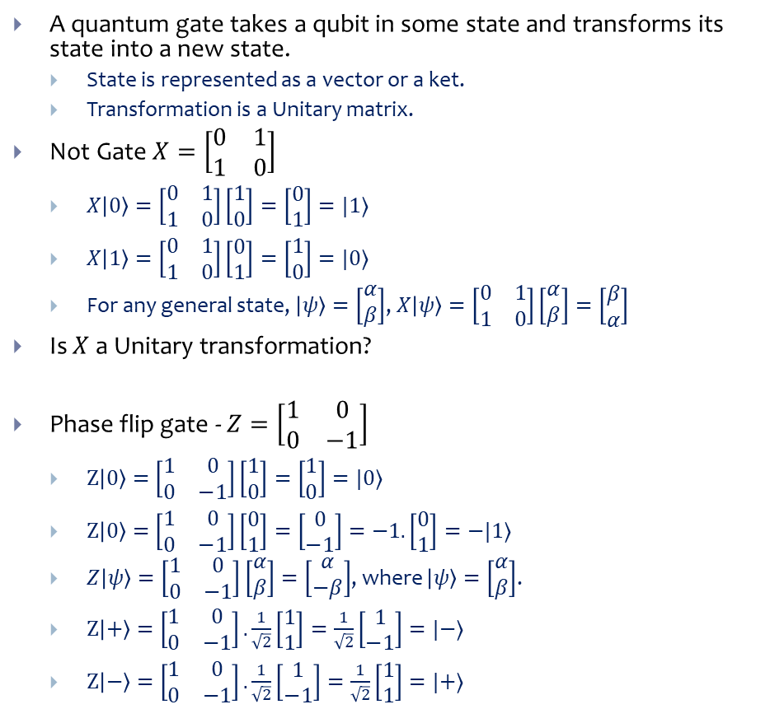



Quantum Gates
A quantum gate takes a qubit in some state and transforms its state into a new state.
State is represented as a vector or a ket.
Transformation is a Unitary matrix.
Not Gate $X=\left[\begin{matrix}0 & 1 \\ 1 & 0\end{matrix}\right]$
$X\left|0\right\rangle =\left[\begin{matrix}0 & 1 \\ 1 & 0\end{matrix}\right]\left[\begin{matrix}1 \\ 0\end{matrix}\right]=\left[\begin{matrix}0 \\ 1\end{matrix}\right]=|1⟩$
$X\left|1\right\rangle =\left[\begin{matrix}0 & 1 \\ 1 & 0\end{matrix}\right]\left[\begin{matrix}0 \\ 1\end{matrix}\right]=\left[\begin{matrix}1 \\ 0\end{matrix}\right]=|0⟩$
For any general state, $\left|ψ\right\rangle =\left[\begin{matrix}α \\ β\end{matrix}\right]$, $X\left|ψ\right\rangle =\left[\begin{matrix}0 & 1 \\ 1 & 0\end{matrix}\right]\left[\begin{matrix}α \\ β\end{matrix}\right]=\left[\begin{matrix}β \\ α\end{matrix}\right]$
Is $X$ a Unitary transformation?
Phase flip gate - $Z=\left[\begin{matrix}1 & 0 \\ 0 & −1\end{matrix}\right]$
$Z\left|0\right\rangle =\left[\begin{matrix}1 & 0 \\ 0 & −1\end{matrix}\right]\left[\begin{matrix}1 \\ 0\end{matrix}\right]=\left[\begin{matrix}1 \\ 0\end{matrix}\right]=|0⟩$
$Z\left|0\right\rangle =\left[\begin{matrix}1 & 0 \\ 0 & −1\end{matrix}\right]\left[\begin{matrix}0 \\ 1\end{matrix}\right]=\left[\begin{matrix}0 \\ −1\end{matrix}\right]=−1.\left[\begin{matrix}0 \\ 1\end{matrix}\right]=−|1⟩$
$Z\left|ψ\right\rangle =\left[\begin{matrix}1 & 0 \\ 0 & −1\end{matrix}\right]\left[\begin{matrix}α \\ β\end{matrix}\right]=\left[\begin{matrix}α \\ −β\end{matrix}\right]$, where $\left|ψ\right\rangle =\left[\begin{matrix}α \\ β\end{matrix}\right]$.
$Z\left|+\right\rangle =\left[\begin{matrix}1 & 0 \\ 0 & −1\end{matrix}\right].\frac{1}{\sqrt{2}}\left[\begin{matrix}1 \\ 1\end{matrix}\right]=\frac{1}{\sqrt{2}}\left[\begin{matrix}1 \\ −1\end{matrix}\right]=|−⟩$
$Z\left|−\right\rangle =\left[\begin{matrix}1 & 0 \\ 0 & −1\end{matrix}\right].\frac{1}{\sqrt{2}}\left[\begin{matrix}1 \\ −1\end{matrix}\right]=\frac{1}{\sqrt{2}}\left[\begin{matrix}1 \\ 1\end{matrix}\right]=|+⟩$
$$|ψ⟩$$
U
$$U|ψ⟩$$
$$α\left|0\right\rangle +β|1⟩$$
X
$$β\left|0\right\rangle +α|1⟩$$
$$α\left|0\right\rangle +β|1⟩$$
Z
$$α\left|0\right\rangle −β|1⟩$$

Slide 3



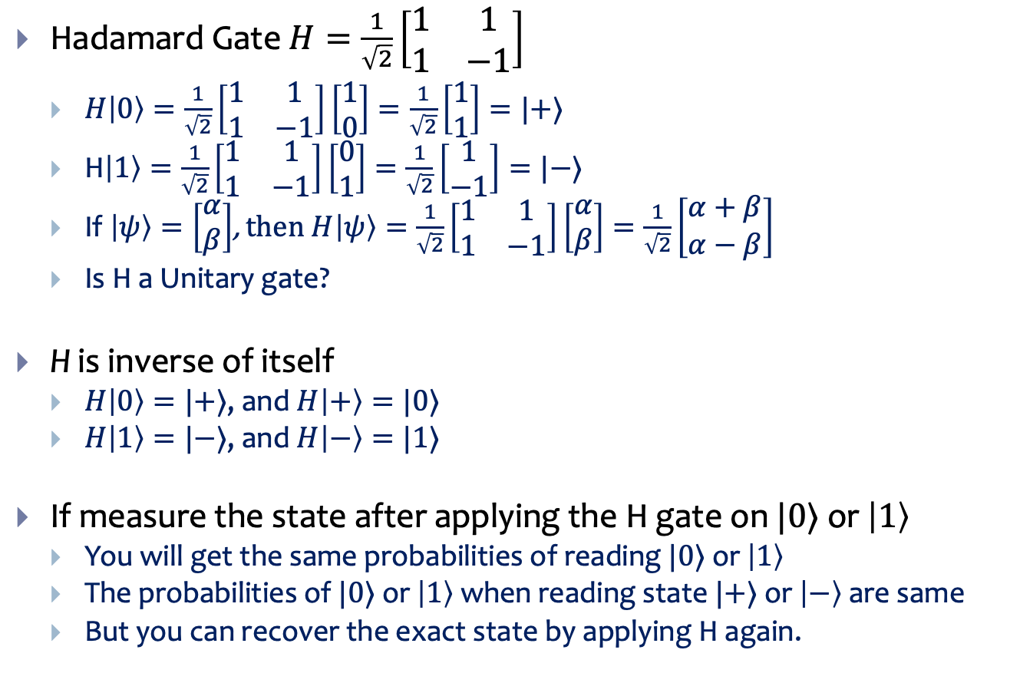


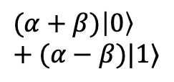
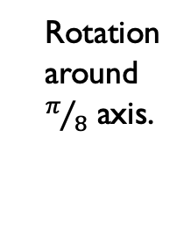
Hadamard Transform
Hadamard Gate $H=\frac{1}{\sqrt{2}}\left[\begin{matrix}1 & 1 \\ 1 & −1\end{matrix}\right]$
$H\left|0\right\rangle =\frac{1}{\sqrt{2}}\left[\begin{matrix}1 & 1 \\ 1 & −1\end{matrix}\right]\left[\begin{matrix}1 \\ 0\end{matrix}\right]=\frac{1}{\sqrt{2}}\left[\begin{matrix}1 \\ 1\end{matrix}\right]=|+⟩$
H$\left|1\right\rangle =\frac{1}{\sqrt{2}}\left[\begin{matrix}1 & 1 \\ 1 & −1\end{matrix}\right]\left[\begin{matrix}0 \\ 1\end{matrix}\right]=\frac{1}{\sqrt{2}}\left[\begin{matrix}1 \\ −1\end{matrix}\right]=|−⟩$
If $\left|ψ\right\rangle =\left[\begin{matrix}α \\ β\end{matrix}\right]$, then $H\left|ψ\right\rangle =\frac{1}{\sqrt{2}}\left[\begin{matrix}1 & 1 \\ 1 & −1\end{matrix}\right]\left[\begin{matrix}α \\ β\end{matrix}\right]=\frac{1}{\sqrt{2}}\left[\begin{matrix}α+β \\ α−β\end{matrix}\right]$
Is H a Unitary gate?
H is inverse of itself
$H\left|0\right\rangle =|+⟩$, and $H\left|+\right\rangle =|0⟩$
$H\left|1\right\rangle =|−⟩$, and $H\left|−\right\rangle =|1⟩$
If measure the state after applying the H gate on $|0⟩$ or $\left|1\right\rangle$
You will get the same probabilities of reading $|0⟩$ or $\left|1\right\rangle$
The probabilities of $|0⟩$ or $\left|1\right\rangle$ when reading state $|+⟩$ or $\left|−\right\rangle$ are same
But you can recover the exact state by applying H again.
$$(α+β)\left|0\right\rangle +(α−β)|1⟩$$
$$α\left|0\right\rangle +β|1⟩$$
H
$$\left|1\right\rangle$$
$$\left|+\right\rangle$$
$$\left|0\right\rangle$$
$$\left|−\right\rangle$$
Rotation around $π/8$ axis.

Slide 4

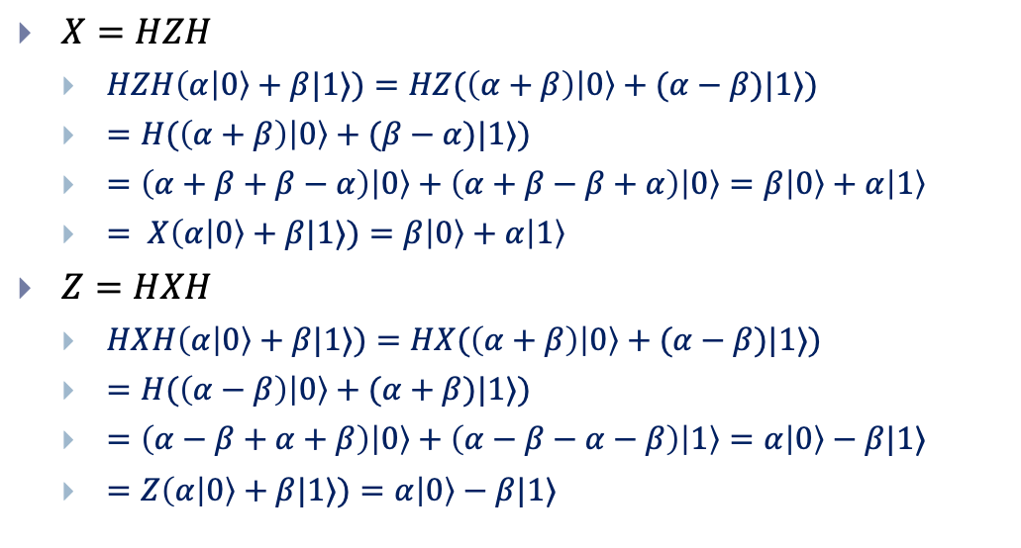


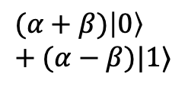

Relationship between XZH
X
H
H
Z
$$α\left|0\right\rangle +β|1⟩$$
X
$$β\left|0\right\rangle +α|1⟩$$
$X=HZH$
$HZH\left(α | 0\right\rangle +β|1⟩)=HZ(\left(α+β\right)\left|0\right\rangle +(α−β)|1⟩)$
$=H(\left(α+β\right)\left|0\right\rangle +(β−α)|1⟩)$
$=\left(α+β+β−α\right)\left|0\right\rangle +\left(α+β−β+α\right)\left|0\right\rangle =β\left|0\right\rangle +α\left|1\right\rangle$
$= X\left(α | 0\right\rangle +β|1⟩)=β\left|0\right\rangle +α\left|1\right\rangle$
$Z=HXH$
$HXH\left(α | 0\right\rangle +β|1⟩)=HX(\left(α+β\right)\left|0\right\rangle +(α−β)|1⟩)$
$=H(\left(α−β\right)\left|0\right\rangle +(α+β)|1⟩)$
$=\left(α−β+α+β\right)\left|0\right\rangle +\left(α−β−α−β\right)\left|1\right\rangle =α\left|0\right\rangle −β|1⟩$
$=Z\left(α | 0\right\rangle +β|1⟩)=α\left|0\right\rangle −β|1⟩$
$$α\left|0\right\rangle +β|1⟩$$
Z
$$α\left|0\right\rangle −β|1⟩$$
$$(α+β)\left|0\right\rangle +(α−β)|1⟩$$
$$α\left|0\right\rangle +β|1⟩$$
H

Slide 5
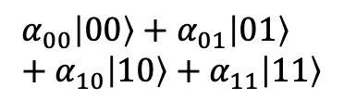
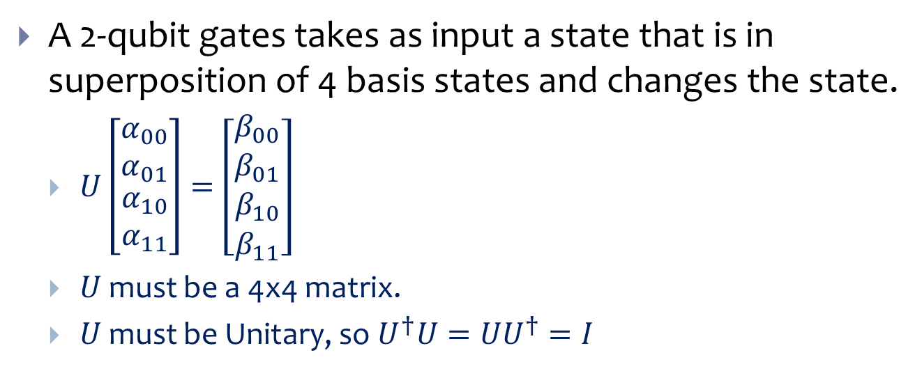

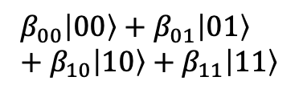
2-Qubit gates
$$α_{00}\left|00\right\rangle +α_{01}\left|01\right\rangle +α_{10}\left|10\right\rangle +α_{11}\left|11\right\rangle$$
U
$$β_{00}\left|00\right\rangle +β_{01}\left|01\right\rangle +β_{10}\left|10\right\rangle +β_{11}\left|11\right\rangle$$
A 2-qubit gates takes as input a state that is in superposition of 4 basis states and changes the state.
$U\left[\begin{matrix}α_{00} \\ α_{01} \\ \begin{matrix}α_{10} \\ α_{11}\end{matrix}\end{matrix}\right]=\left[\begin{matrix}β_{00} \\ β_{01} \\ \begin{matrix}β_{10} \\ β_{11}\end{matrix}\end{matrix}\right]$
$U$ must be a 4x4 matrix.
$U$ must be Unitary, so $U^{†}U={UU}^{†}=I$
$U=\left[\begin{matrix} & & \begin{matrix} & \end{matrix} \\ & & \begin{matrix} & \end{matrix} \\ \begin{matrix} \\ \end{matrix} & \begin{matrix} \\ \end{matrix} & \begin{matrix}\begin{matrix} & \end{matrix} \\ \begin{matrix} & \end{matrix}\end{matrix}\end{matrix}\right]$

Slide 6
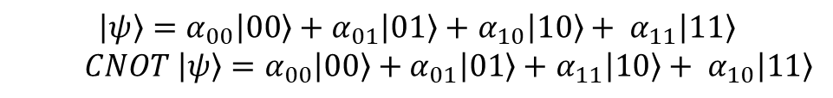

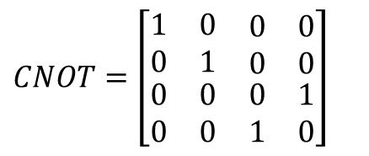
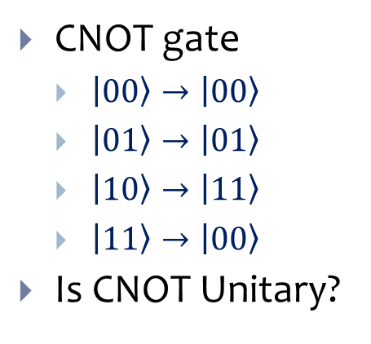



CNOT gate
$$a$$
$$a$$
$CNOT=\left[\begin{matrix}1 & 0 & \begin{matrix}0 & 0\end{matrix} \\ 0 & 1 & \begin{matrix}0 & 0\end{matrix} \\ \begin{matrix}0 \\ 0\end{matrix} & \begin{matrix}0 \\ 0\end{matrix} & \begin{matrix}\begin{matrix}0 & 1\end{matrix} \\ \begin{matrix}1 & 0\end{matrix}\end{matrix}\end{matrix}\right]$
$$b$$
$$b⨁a$$
$\left|ψ\right\rangle =α_{00}\left|00\right\rangle +α_{01}\left|01\right\rangle +$ $α_{10}\left|10\right\rangle + α_{11}\left|11\right\rangle$
$CNOT \left|ψ\right\rangle =α_{00}\left|00\right\rangle +α_{01}\left|01\right\rangle +$ $α_{11}\left|10\right\rangle + α_{10}\left|11\right\rangle$
CNOT gate
$\left|00\right\rangle →\left|00\right\rangle$
$\left|01\right\rangle →\left|01\right\rangle$
$\left|10\right\rangle →\left|11\right\rangle$
$\left|11\right\rangle →\left|00\right\rangle$
Is CNOT Unitary?

Slide 7



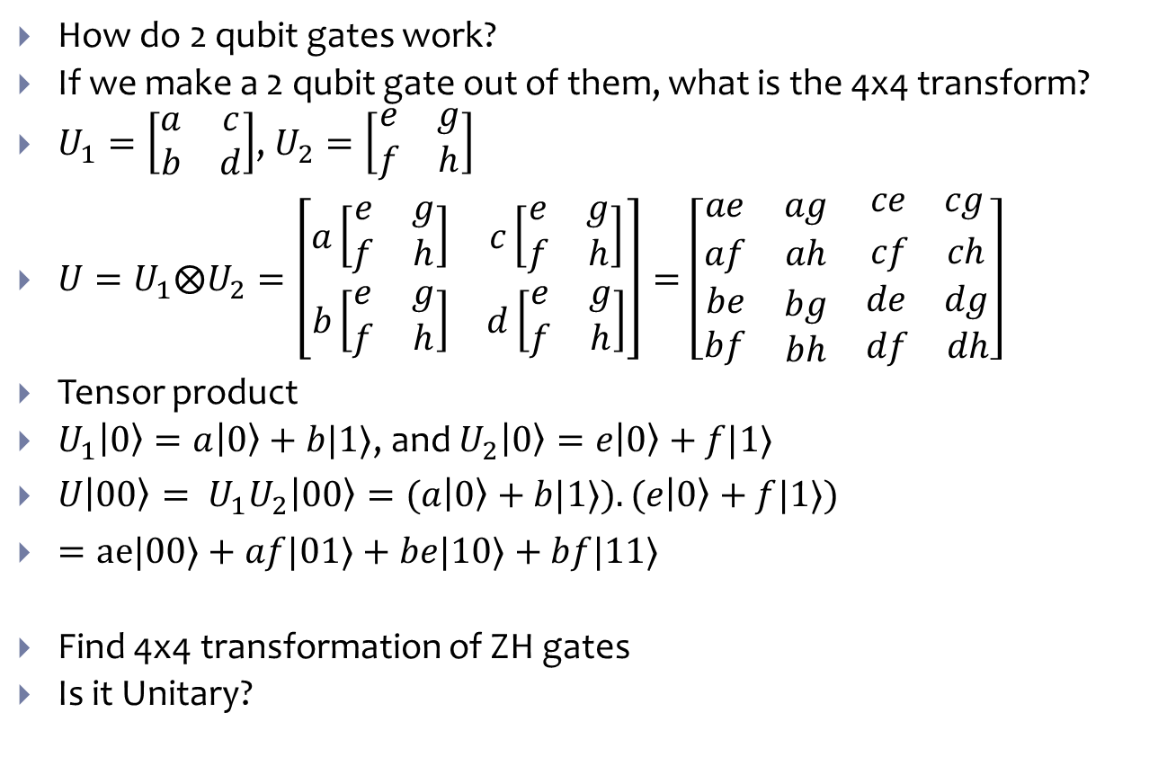



Multi-qubit gates
How do 2 qubit gates work?
If we make a 2 qubit gate out of them, what is the 4x4 transform?
$U_{1}=\left[\begin{matrix}a & c \\ b & d\end{matrix}\right]$, $U_{2}=\left[\begin{matrix}e & g \\ f & h\end{matrix}\right]$
$U=U_{1}⨂U_{2}=\left[\begin{matrix}a\left[\begin{matrix}e & g \\ f & h\end{matrix}\right] & c\left[\begin{matrix}e & g \\ f & h\end{matrix}\right] \\ b\left[\begin{matrix}e & g \\ f & h\end{matrix}\right] & d\left[\begin{matrix}e & g \\ f & h\end{matrix}\right]\end{matrix}\right]=\left[\begin{matrix}ae & ag & \begin{matrix}ce & cg\end{matrix} \\ af & ah & \begin{matrix}cf & ch\end{matrix} \\ \begin{matrix}be \\ bf\end{matrix} & \begin{matrix}bg \\ bh\end{matrix} & \begin{matrix}\begin{matrix}de & dg\end{matrix} \\ \begin{matrix}df & dh\end{matrix}\end{matrix}\end{matrix}\right]$
Tensor product
$U_{1}\left|0\right\rangle =a\left|0\right\rangle +b|1⟩$, and $U_{2}\left|0\right\rangle =e\left|0\right\rangle +f|1⟩$
$U\left|00\right\rangle = U_{1}U_{2}\left|00\right\rangle =(a\left|0\right\rangle +b|1⟩).(e\left|0\right\rangle +f|1⟩)$
$=ae|00⟩+af|01⟩+be|10⟩+bf|11⟩$
Find 4x4 transformation of ZH gates
Is it Unitary?
$$U_{1}$$
$$U_{2}$$
$$U_{1}$$
$$U_{2}$$
$$Z$$
$$H$$

Slide 8
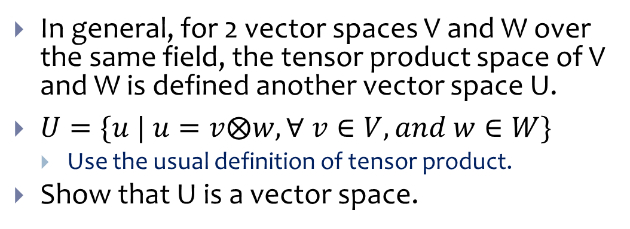
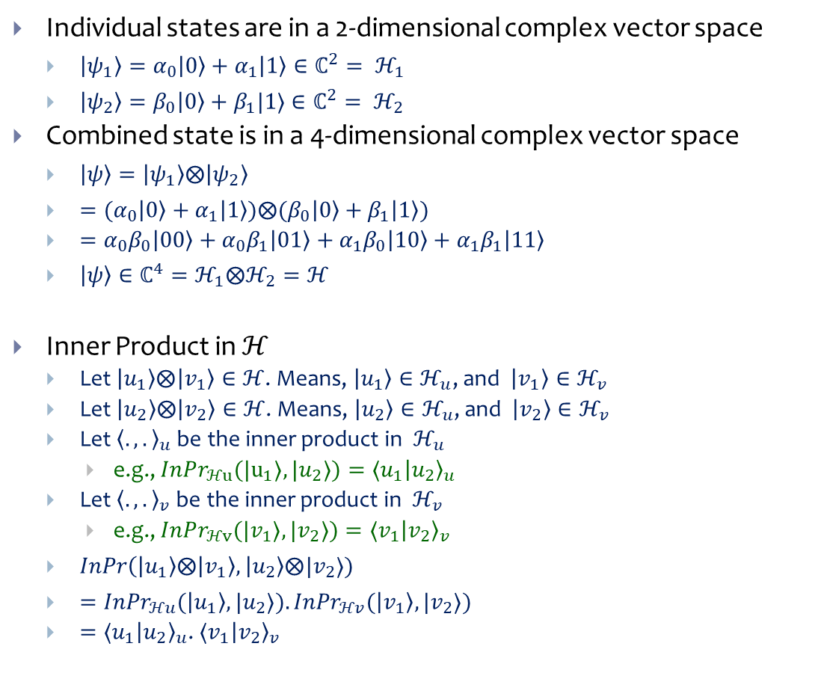
Tensor Product Spaces
Individual states are in a 2-dimensional complex vector space
$\left|ψ_{1}\right\rangle =α_{0}\left|0\right\rangle +α_{1}\left|1\right\rangle ∈ℂ^{2}= ℋ_{1}$
$\left|ψ_{2}\right\rangle =β_{0}\left|0\right\rangle +β_{1}|1⟩∈ℂ^{2}= ℋ_{2}$
Combined state is in a 4-dimensional complex vector space
$\left|ψ\right\rangle =\left|ψ_{1}\right\rangle ⨂\left|ψ_{2}\right\rangle$
$={(α}_{0}\left|0\right\rangle +α_{1}\left|1\right\rangle )⨂{(β}_{0}\left|0\right\rangle +β_{1}\left|1\right\rangle )$
$=α_{0}β_{0}\left|00\right\rangle +α_{0}β_{1}\left|01\right\rangle +$ $α_{1}β_{0}\left|10\right\rangle +$ $α_{1}β_{1}\left|11\right\rangle$
$\left|ψ\right\rangle ∈ℂ^{4}=ℋ_{1}⨂ℋ_{2}=ℋ$
Inner Product in $ℋ$
Let $\left|u_{1}\right\rangle ⨂\left|v_{1}\right\rangle ∈ℋ$. Means, $\left|u_{1}\right\rangle ∈ℋ_{u}$, and $\left|v_{1}\right\rangle ∈ℋ_{v}$
Let $\left|u_{2}\right\rangle ⨂\left|v_{2}\right\rangle ∈ℋ$. Means, $\left|u_{2}\right\rangle ∈ℋ_{u}$, and $\left|v_{2}\right\rangle ∈ℋ_{v}$
Let ${\left\langle .,.\right\rangle }_{u}$ be the inner product in $ℋ_{u}$
e.g., $InPr_{ℋu}({|u}_{1}⟩, |u_{2}⟩)=⟨u_{1}{\left|u_{2}\right\rangle }_{u}$
Let ${\left\langle .,.\right\rangle }_{v}$ be the inner product in $ℋ_{v}$
e.g., $InPr_{ℋv}({|v}_{1}⟩, |v_{2}⟩)=⟨v_{1}{\left|v_{2}\right\rangle }_{v}$
$InPr\left(\left|u_{1}\right\rangle ⨂ | v_{1}\right\rangle ,\left|u_{2}\right\rangle ⨂|v_{2}⟩)$
$={InPr}_{ℋu}(\left|u_{1}\right\rangle , |u_{2}⟩). {InPr}_{ℋv}(\left|v_{1}\right\rangle , |v_{2}⟩)$
$=⟨u_{1}{\left|u_{2}\right\rangle }_{u}$. $⟨v_{1}{\left|v_{2}\right\rangle }_{v}$
In general, for 2 vector spaces V and W over the same field, the tensor product space of V and W is defined another vector space U.
$U=\{u | u=v⨂w, ∀ v∈V, and w∈W\}$
Use the usual definition of tensor product.
Show that U is a vector space.

Slide 9

























Tensor Products
$$\left|1\right\rangle$$
$$\left|1\right\rangle$$
$$\left|0\right\rangle$$
$$\left|0\right\rangle$$
$$α_{0}\left|0\right\rangle +α_{1}|1⟩$$
$$β_{0}\left|0\right\rangle +β_{1}|1⟩$$
$α_{0}β_{0}\left|00\right\rangle +α_{0}β_{1}\left|01\right\rangle +$ $α_{1}β_{0}\left|10\right\rangle +$ $α_{1}β_{1}\left|11\right\rangle$
Vector space
$$∈ℂ^{2}$$
$$∈ℂ^{2}$$
$$∈ℂ^{4}$$
$$ℋ_{1}$$
$$ℋ_{2}$$
$$ℋ$$
$$|u⟩$$
$$|v⟩$$
$$\left|u\right\rangle ⨂\left|v\right\rangle$$
$$|u_{1}⟩+{|u}_{2}⟩$$
$$|v⟩$$
$$(\left|u_{1}\right\rangle +|u_{2}⟩)⨂\left|v\right\rangle$$
$$|u⟩$$
$$\left|v_{1}\right\rangle +|v_{2}⟩$$
$$|u⟩⨂(\left|v_{1}\right\rangle +|v_{2}⟩)$$
$$|0⟩$$
$$\left|0\right\rangle$$
$$\left|0\right\rangle ⨂\left|0\right\rangle =\left|0\right\rangle \left|0\right\rangle =|00⟩$$
$$|1⟩$$
$$\left|0\right\rangle$$
$$|10⟩$$

Slide 10

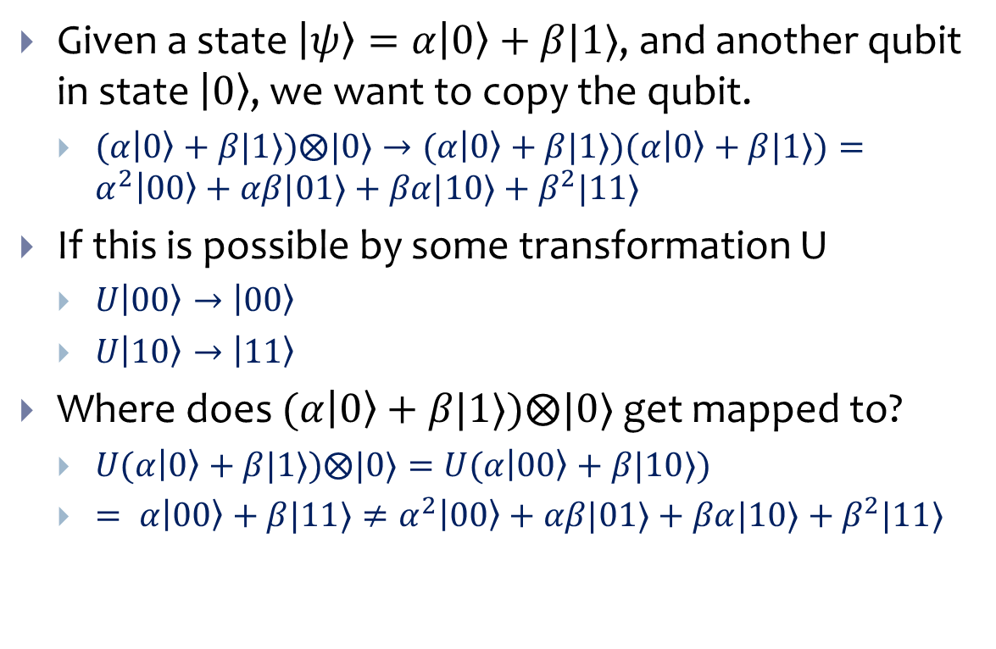



No Cloning Theorem
Given a state $\left|ψ\right\rangle =α\left|0\right\rangle +β|1⟩$, and another qubit in state $\left|0\right\rangle$, we want to copy the qubit.
$(α\left|0\right\rangle +β|1⟩)⨂|0⟩→(α\left|0\right\rangle +β|1⟩)(α\left|0\right\rangle +β|1⟩)=α^{2}\left|00\right\rangle +αβ|01⟩+βα|10⟩+β^{2}|11⟩$
If this is possible by some transformation U
$U\left|00\right\rangle →\left|00\right\rangle$
$U\left|10\right\rangle →\left|11\right\rangle$
Where does $(α\left|0\right\rangle +β|1⟩)⨂|0⟩$ get mapped to?
$U(α\left|0\right\rangle +β|1⟩)⨂|0⟩=U(α\left|00\right\rangle +β|10⟩)$
$= α\left|00\right\rangle +β|11⟩≠α^{2}\left|00\right\rangle +αβ|01⟩+βα|10⟩+β^{2}|11⟩$
$$\left|ψ\right\rangle$$
$$\left|ψ\right\rangle =α\left|0\right\rangle +β\left|1\right\rangle$$
U
$$\left|0\right\rangle$$
$$\left|ψ\right\rangle$$
No-cloning theorem: There is no Unitary transformation that copies a qubit.

Slide 11



Quantum Teleportation
Alice
Bob
How can Alice transfer a qubit in unknown state to Bob.
Cannot measure as that destroys the qubit state.
And learn very little about the state.
Problem especially important because of the no-cloning theorem.
$$\left|ψ_{1}\right\rangle =α\left|0\right\rangle +β|1⟩$$

Slide 12

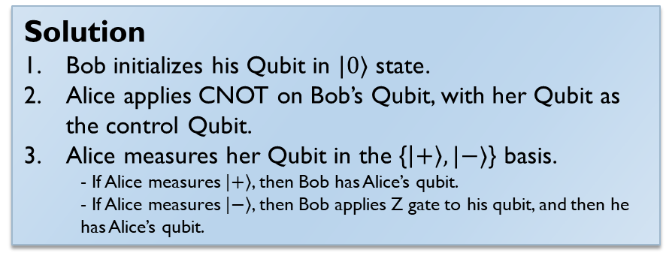
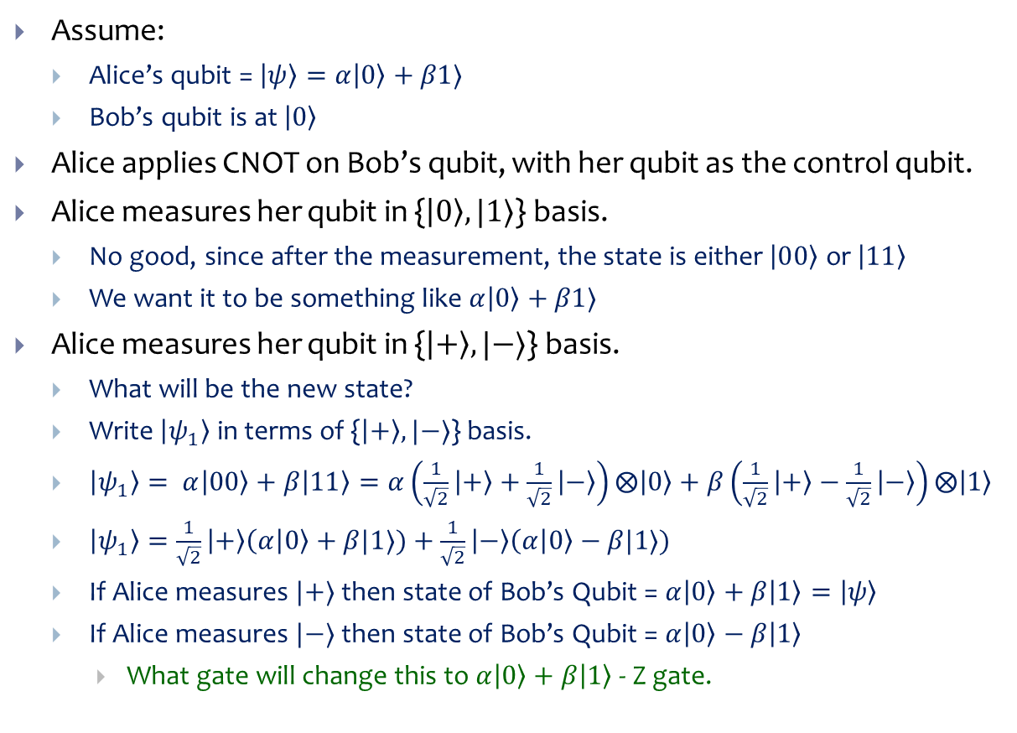
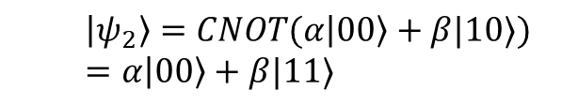
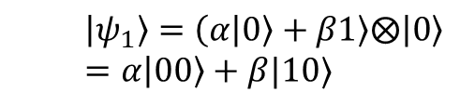

Using CNOT Gate
$$\left|ψ_{2}\right\rangle =CNOT(α\left|00\right\rangle +β|10⟩)=α\left|00\right\rangle +β|11⟩$$
Assume:
Alice’s qubit = $\left|ψ\right\rangle =α\left|0\right\rangle +β1⟩$
Bob’s qubit is at $\left|0\right\rangle$
Alice applies CNOT on Bob’s qubit, with her qubit as the control qubit.
Alice measures her qubit in {$\left|0\right\rangle , |1⟩$} basis.
No good, since after the measurement, the state is either $\left|00\right\rangle$ or $\left|11\right\rangle$
We want it to be something like $α\left|0\right\rangle +β1⟩$
Alice measures her qubit in {$\left|+\right\rangle , |−⟩$} basis.
What will be the new state?
Write $\left|ψ_{1}\right\rangle$ in terms of {$\left|+\right\rangle , |−⟩$} basis.
$\left|ψ_{1}\right\rangle = α\left|00\right\rangle +β\left|11\right\rangle =α\left(\frac{1}{\sqrt{2}}\left|+\right\rangle +\frac{1}{\sqrt{2}}\left|−\right\rangle \right)⨂\left|0\right\rangle +β\left(\frac{1}{\sqrt{2}}\left|+\right\rangle −\frac{1}{\sqrt{2}}\left|−\right\rangle \right)⨂\left|1\right\rangle$
$\left|ψ_{1}\right\rangle =\frac{1}{\sqrt{2}}\left|+\right\rangle \left(α | 0\right\rangle +β|1⟩)+\frac{1}{\sqrt{2}}\left|−\right\rangle \left(α | 0\right\rangle −β|1⟩)$
If Alice measures $|+⟩$ then state of Bob’s Qubit = $α\left|0\right\rangle +β\left|1\right\rangle =\left|ψ\right\rangle$
If Alice measures $|−⟩$ then state of Bob’s Qubit = $α\left|0\right\rangle −β\left|1\right\rangle$
What gate will change this to $α\left|0\right\rangle +β\left|1\right\rangle$ - Z gate.
$$α\left|0\right\rangle +β|1⟩$$
Alice’s Qubit
Bob’s Qubit
$$|0⟩$$
$$\left|ψ_{1}\right\rangle =\left(α\left|0\right\rangle +β1\right\rangle ⨂\left|0\right\rangle =α\left|00\right\rangle +β|10⟩$$
Solution
Bob initializes his Qubit in $|0⟩$ state.
Alice applies CNOT on Bob’s Qubit, with her Qubit as the control Qubit.
Alice measures her Qubit in the {$\left|+\right\rangle , |−⟩$} basis.
- If Alice measures $|+⟩$, then Bob has Alice’s qubit.
- If Alice measures $|−⟩$, then Bob applies Z gate to his qubit, and then he has Alice’s qubit.

Slide 13

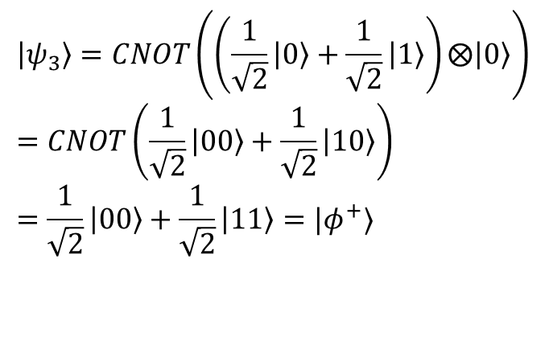
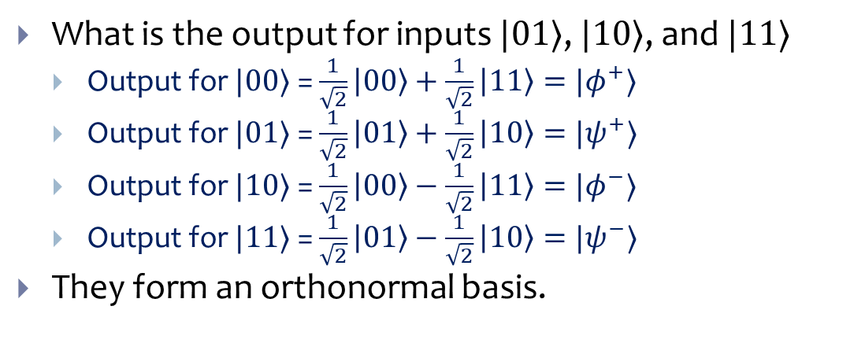
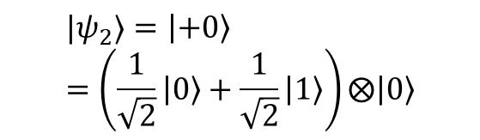


Bell State Circuit
$$\left|0\right\rangle$$
H
$$\left|ψ_{3}\right\rangle =CNOT\left(\left(\frac{1}{\sqrt{2}}\left|0\right\rangle +\frac{1}{\sqrt{2}}\left|1\right\rangle \right)⨂\left|0\right\rangle \right)=CNOT\left(\frac{1}{\sqrt{2}}\left|00\right\rangle +\frac{1}{\sqrt{2}}\left|10\right\rangle \right)=\frac{1}{\sqrt{2}}\left|00\right\rangle +\frac{1}{\sqrt{2}}\left|11\right\rangle =|φ^{+}⟩$$
$$\left|0\right\rangle$$
$$\left|ψ_{1}\right\rangle =\left|00\right\rangle$$
$$|ψ_{2}⟩=\left|+0\right\rangle =\left(\frac{1}{\sqrt{2}}\left|0\right\rangle +\frac{1}{\sqrt{2}}\left|1\right\rangle \right)⨂\left|0\right\rangle$$
What is the output for inputs $|01⟩$, $|10⟩$, and $|11⟩$
Output for $|00⟩$ = $\frac{1}{\sqrt{2}}\left|00\right\rangle +\frac{1}{\sqrt{2}}\left|11\right\rangle =|φ^{+}⟩$
Output for $|01⟩$ = $\frac{1}{\sqrt{2}}\left|01\right\rangle +\frac{1}{\sqrt{2}}\left|10\right\rangle =|ψ^{+}⟩$
Output for $|10⟩$ = $\frac{1}{\sqrt{2}}\left|00\right\rangle −\frac{1}{\sqrt{2}}\left|11\right\rangle =|φ^{−}⟩$
Output for $|11⟩$ = $\frac{1}{\sqrt{2}}\left|01\right\rangle −\frac{1}{\sqrt{2}}\left|10\right\rangle =|ψ^{−}⟩$
They form an orthonormal basis.

Slide 14


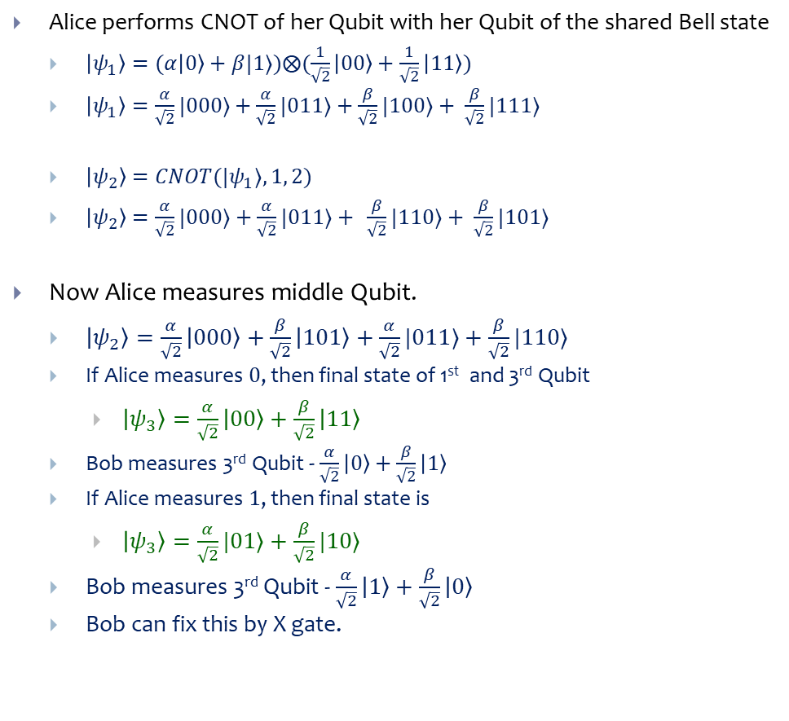




Using Bell State
Alice performs CNOT of her Qubit with her Qubit of the shared Bell state
$\left|ψ_{1}\right\rangle =(α\left|0\right\rangle +β|1⟩)⨂(\frac{1}{\sqrt{2}}\left|00\right\rangle +\frac{1}{\sqrt{2}}\left|11\right\rangle )$
$\left|ψ_{1}\right\rangle =\frac{α}{\sqrt{2}}|000⟩+\frac{α}{\sqrt{2}}|011⟩+$ $\frac{β}{\sqrt{2}}|100⟩+ \frac{β}{\sqrt{2}}|111⟩$
$\left|ψ_{2}\right\rangle =CNOT(|ψ_{1}⟩, 1, 2)$
$\left|ψ_{2}\right\rangle =\frac{α}{\sqrt{2}}|000⟩+\frac{α}{\sqrt{2}}|011⟩+ \frac{β}{\sqrt{2}}|110⟩+ \frac{β}{\sqrt{2}}|101⟩$
Now Alice measures middle Qubit.
$\left|ψ_{2}\right\rangle =\frac{α}{\sqrt{2}}\left|000\right\rangle +\frac{β}{\sqrt{2}}\left|101\right\rangle +\frac{α}{\sqrt{2}}|011⟩+\frac{β}{\sqrt{2}}|110⟩$
If Alice measures $0$, then final state of 1st and 3rd Qubit
$\left|ψ_{3}\right\rangle =\frac{α}{\sqrt{2}}\left|00\right\rangle +\frac{β}{\sqrt{2}}\left|11\right\rangle$
Bob measures 3rd Qubit - $\frac{α}{\sqrt{2}}\left|0\right\rangle +\frac{β}{\sqrt{2}}\left|1\right\rangle$
If Alice measures $1$, then final state is
$\left|ψ_{3}\right\rangle =\frac{α}{\sqrt{2}}|01⟩+\frac{β}{\sqrt{2}}|10⟩$
Bob measures 3rd Qubit - $\frac{α}{\sqrt{2}}\left|1\right\rangle +\frac{β}{\sqrt{2}}\left|0\right\rangle$
Bob can fix this by X gate.
$$α\left|0\right\rangle +β|1⟩$$
Alice
$$\left(\frac{1}{\sqrt{2}}\left|00\right\rangle +\frac{1}{\sqrt{2}}\left|11\right\rangle \right)$$
Bob
$$\left|ψ_{1}\right\rangle$$
$$\left|ψ_{2}\right\rangle$$
$$\left|ψ_{3}\right\rangle$$

Slide 15


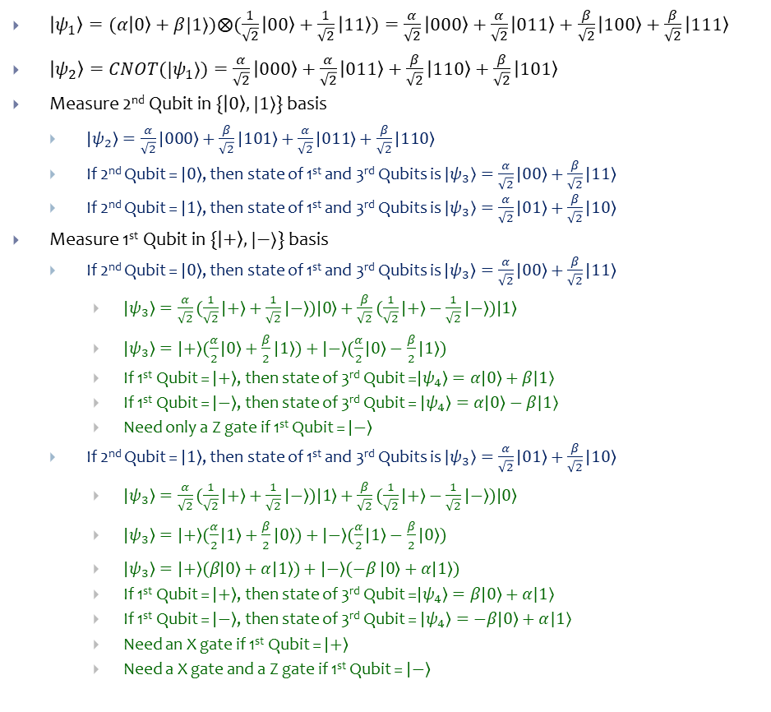





Complete Teleportation Protocol
$$\left|ψ\right\rangle$$
H
$\left|ψ_{1}\right\rangle =(α\left|0\right\rangle +β|1⟩)⨂(\frac{1}{\sqrt{2}}\left|00\right\rangle +\frac{1}{\sqrt{2}}\left|11\right\rangle )=\frac{α}{\sqrt{2}}\left|000\right\rangle +\frac{α}{\sqrt{2}}\left|011\right\rangle +\frac{β}{\sqrt{2}}\left|100\right\rangle +\frac{β}{\sqrt{2}}\left|111\right\rangle$
$\left|ψ_{2}\right\rangle =CNOT(|ψ_{1}⟩)=\frac{α}{\sqrt{2}}\left|000\right\rangle +\frac{α}{\sqrt{2}}\left|011\right\rangle +\frac{β}{\sqrt{2}}\left|110\right\rangle +\frac{β}{\sqrt{2}}\left|101\right\rangle$
Measure 2nd Qubit in {$\left|0\right\rangle ,|1⟩$} basis
$\left|ψ_{2}\right\rangle =\frac{α}{\sqrt{2}}\left|000\right\rangle +\frac{β}{\sqrt{2}}\left|101\right\rangle +\frac{α}{\sqrt{2}}\left|011\right\rangle +\frac{β}{\sqrt{2}}\left|110\right\rangle$
If 2nd Qubit = $\left|0\right\rangle$, then state of 1st and 3rd Qubits is $|ψ_{3}⟩=\frac{α}{\sqrt{2}}\left|00\right\rangle +\frac{β}{\sqrt{2}}\left|11\right\rangle$
If 2nd Qubit = $\left|1\right\rangle$, then state of 1st and 3rd Qubits is $|ψ_{3}⟩=\frac{α}{\sqrt{2}}\left|01\right\rangle +\frac{β}{\sqrt{2}}\left|10\right\rangle$
Measure 1st Qubit in {$\left|+\right\rangle ,|−⟩$} basis
If 2nd Qubit = $\left|0\right\rangle$, then state of 1st and 3rd Qubits is $\left|ψ_{3}\right\rangle =\frac{α}{\sqrt{2}}\left|00\right\rangle +\frac{β}{\sqrt{2}}\left|11\right\rangle$
$\left|ψ_{3}\right\rangle =\frac{α}{\sqrt{2}}(\frac{1}{\sqrt{2}}\left|+\right\rangle +\frac{1}{\sqrt{2}}\left|−\right\rangle )\left|0\right\rangle +\frac{β}{\sqrt{2}}(\frac{1}{\sqrt{2}}\left|+\right\rangle −\frac{1}{\sqrt{2}}\left|−\right\rangle )\left|1\right\rangle$
$\left|ψ_{3}\right\rangle =\left|+\right\rangle (\frac{α}{2}\left|0\right\rangle +\frac{β}{2}\left|1\right\rangle )+\left|−\right\rangle (\frac{α}{2}\left|0\right\rangle −\frac{β}{2}\left|1\right\rangle )$
If 1st Qubit = $\left|+\right\rangle$, then state of 3rd Qubit =$\left|ψ_{4}\right\rangle =α\left|0\right\rangle +β|1⟩$
If 1st Qubit = $\left|−\right\rangle$, then state of 3rd Qubit = $\left|ψ_{4}\right\rangle =α\left|0\right\rangle −β|1⟩$
Need only a Z gate if 1st Qubit = $\left|−\right\rangle$
If 2nd Qubit = $\left|1\right\rangle$, then state of 1st and 3rd Qubits is $|ψ_{3}⟩=\frac{α}{\sqrt{2}}\left|01\right\rangle +\frac{β}{\sqrt{2}}\left|10\right\rangle$
$\left|ψ_{3}\right\rangle =\frac{α}{\sqrt{2}}(\frac{1}{\sqrt{2}}\left|+\right\rangle +\frac{1}{\sqrt{2}}\left|−\right\rangle )\left|1\right\rangle +\frac{β}{\sqrt{2}}(\frac{1}{\sqrt{2}}\left|+\right\rangle −\frac{1}{\sqrt{2}}\left|−\right\rangle )\left|0\right\rangle$
$\left|ψ_{3}\right\rangle =\left|+\right\rangle (\frac{α}{2}\left|1\right\rangle +\frac{β}{2}\left|0\right\rangle )+\left|−\right\rangle (\frac{α}{2}\left|1\right\rangle −\frac{β}{2}\left|0\right\rangle )$
$\left|ψ_{3}\right\rangle =\left|+\right\rangle (β\left|0\right\rangle +α\left|1\right\rangle )+\left|−\right\rangle (−β \left|0\right\rangle +α\left|1\right\rangle )$
If 1st Qubit = $\left|+\right\rangle$, then state of 3rd Qubit =$\left|ψ_{4}\right\rangle =β\left|0\right\rangle +α|1⟩$
If 1st Qubit = $\left|−\right\rangle$, then state of 3rd Qubit = $\left|ψ_{4}\right\rangle =−β\left|0\right\rangle +α|1⟩$
Need an X gate if 1st Qubit = $\left|+\right\rangle$
Need a X gate and a Z gate if 1st Qubit = $\left|−\right\rangle$
$$\left(\frac{1}{\sqrt{2}}\left|00\right\rangle +\frac{1}{\sqrt{2}}\left|11\right\rangle \right)$$
Telephone call
Alice
Bob
X
Z
$$\left|ψ\right\rangle$$
$$\left|ψ_{2}\right\rangle$$
$$\left|ψ_{3}\right\rangle$$
$$\left|ψ_{4}\right\rangle$$
$$\left|ψ_{1}\right\rangle$$

Slide 16












Multi-bit Entanglement
$$\left|ψ\right\rangle =α\left|0\right\rangle +β|1⟩$$
$$\left|ψ\right\rangle =α\left|0\right\rangle +β|1⟩$$
$$\left|0\right\rangle$$
$$\left|ψ\right\rangle =α\left|00\right\rangle +β|11⟩$$
$$\left|ψ\right\rangle =α\left|0\right\rangle +β|1⟩$$
$$\left|0\right\rangle$$
$$\left|0\right\rangle$$
$$\left|0\right\rangle$$
$$\left|ψ_{4}\right\rangle =α\left|0000\right\rangle +β|1111⟩$$
$$\left|ψ_{3}\right\rangle =α\left|0000\right\rangle +β|1110⟩$$
$$\left|ψ_{2}\right\rangle =α\left|0000\right\rangle +β|1100⟩$$
$$\left|ψ_{1}\right\rangle =α\left|0000\right\rangle +β|0000⟩$$

Slide 17



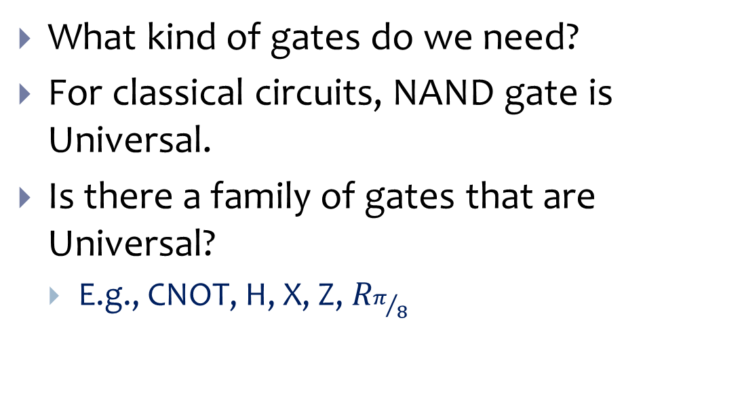



Quantum Circuit
$$|0⟩$$
H
X
Classical outputs
$$|0⟩$$
CNOT
Z
$$|0⟩$$
$$|0⟩$$
What kind of gates do we need?
For classical circuits, NAND gate is Universal.
Is there a family of gates that are Universal?
E.g., CNOT, H, X, Z, $R_{π/8}$
Z
$$|0⟩$$
X
Z

